Slide 1
1119
john

Slide 2
Last time…WWL distance matrix
Shape: (sample, feature)= N*N (1553*1553)
Value: positive, except diagonal elements
Calculate outlier by:
1. iqr = q3 - q1, remove sample > q3 + 1.5 * iqr & sample < q1 - 1.5 * iqr
Red means outliers removed, black means total original samples in highlight cluster
2. Local outlier factor (in sklearn)
Not obvious
Group | 2 | 3 | 5 | 6 | 7 | 8 | 9 | 15
fastermsc | 3/27 | 18/199 | 1/6 | 4/83 | 11/11 | 14/476 | 7/132 | 5/18
Group | -1 | 0 | 1 | 12
hbdscan | 47/993 | 4/126 | 2/25 | 10/11
Group | 2 | 8 | 13 | 21 | 24
kmeans | 5/47 | 33/33 | 6/6 | 1/46 | 18/20

Slide 3
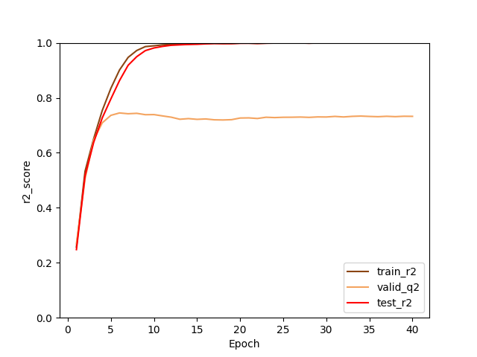
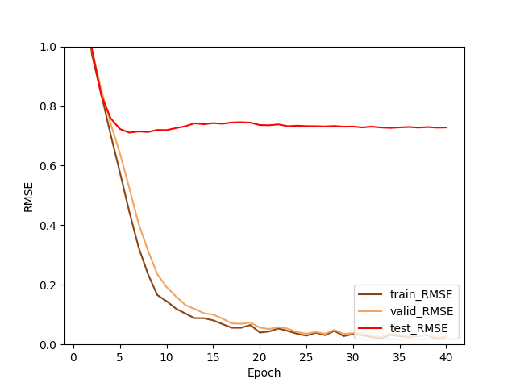
IQR result
r2
train: 0.9722
Valid: 0.9498
Test: 0.7436
RMSE
Train: 0.2366
Valid: 0.3157
Test: 0.7129

Slide 4
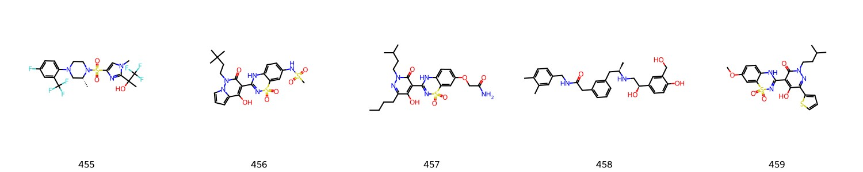
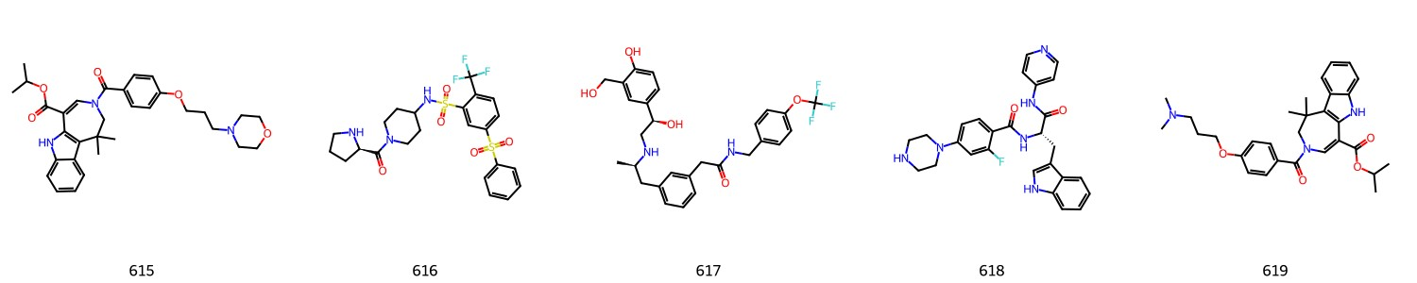
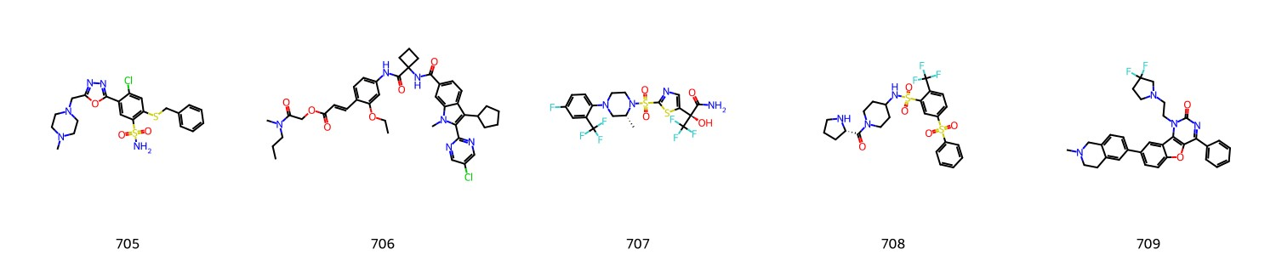
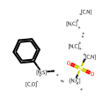
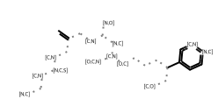
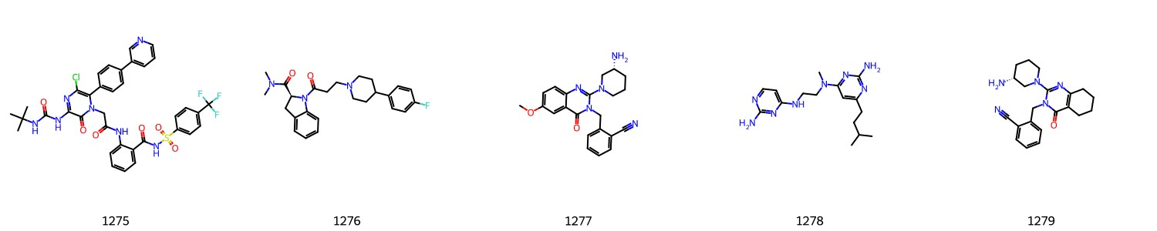
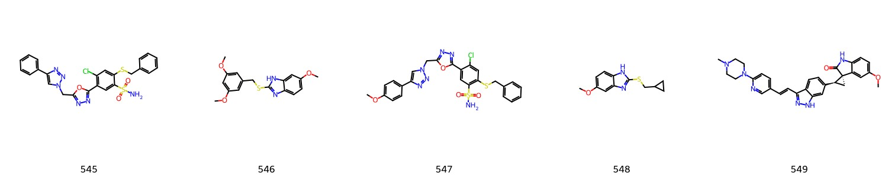
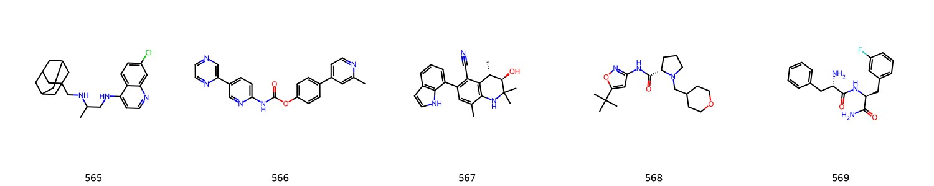
Kmeans, group 8
(33/33)
Group 8.1
Group 8.2

Slide 5
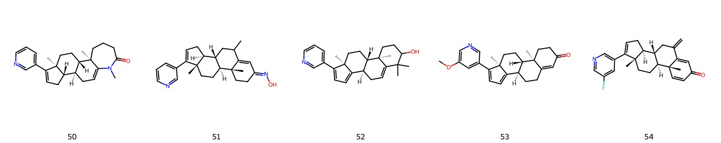
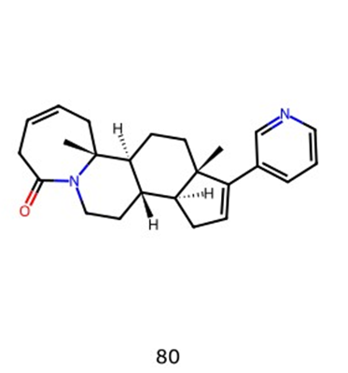
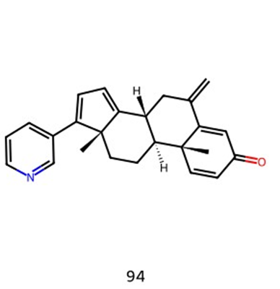
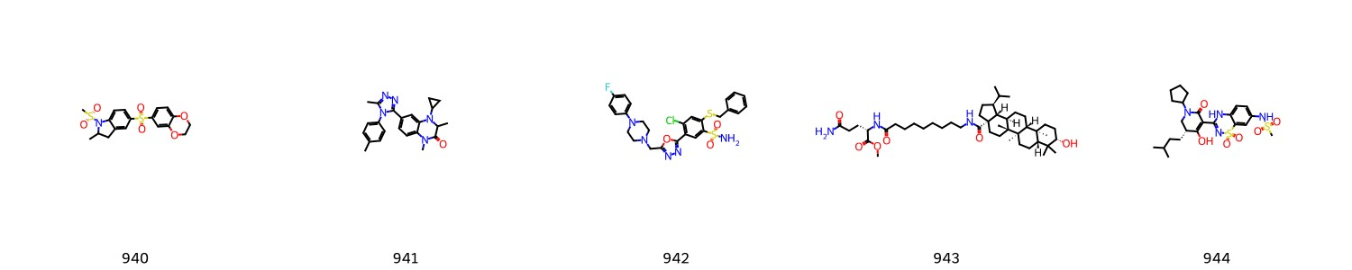
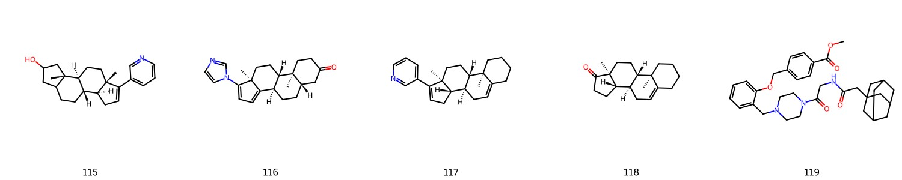
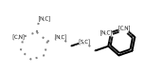
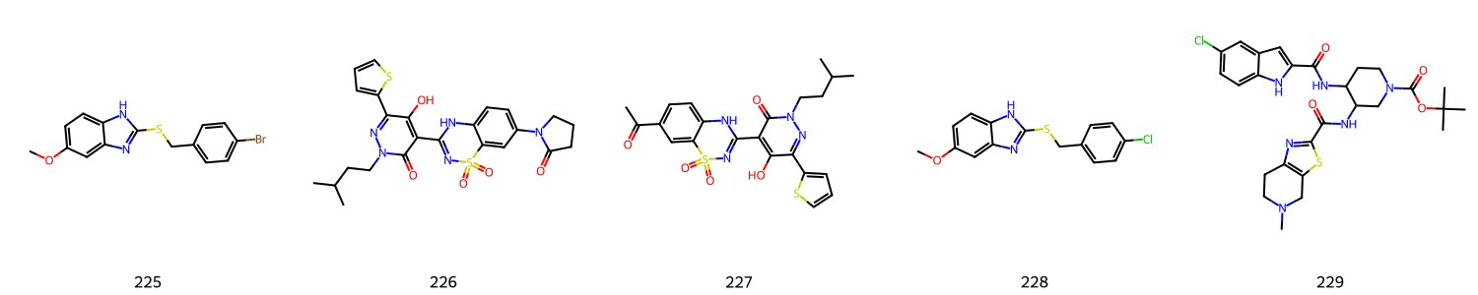
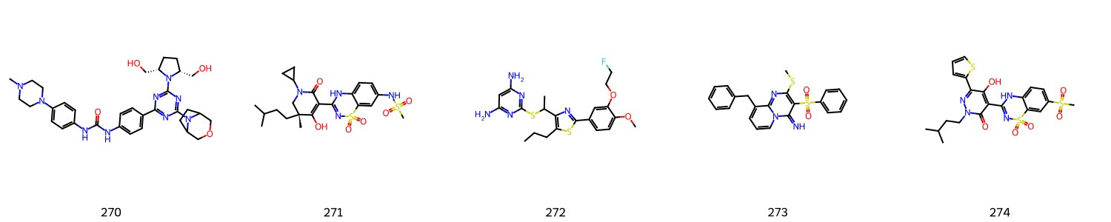
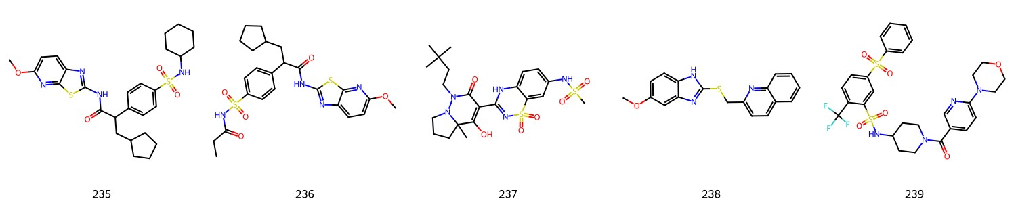
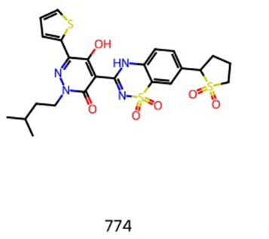
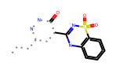
Group 8.3
Group 8.4

Slide 6
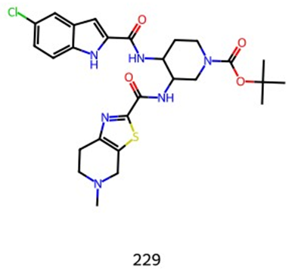
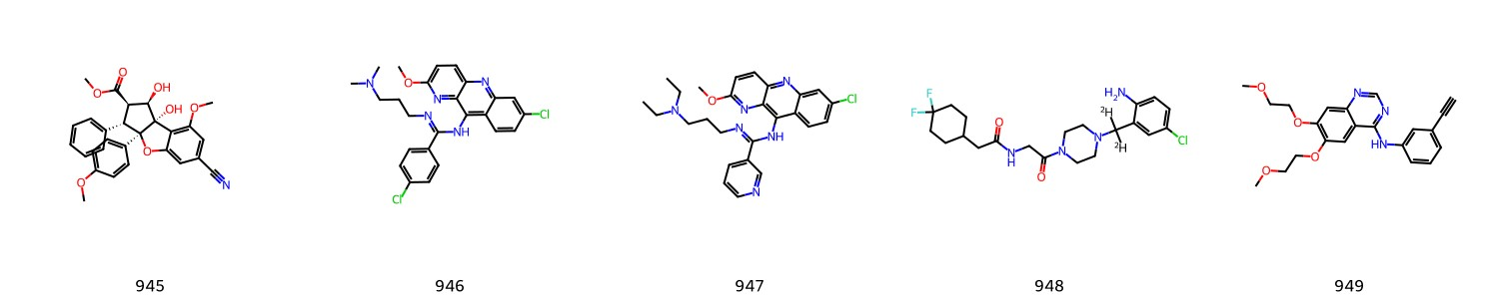
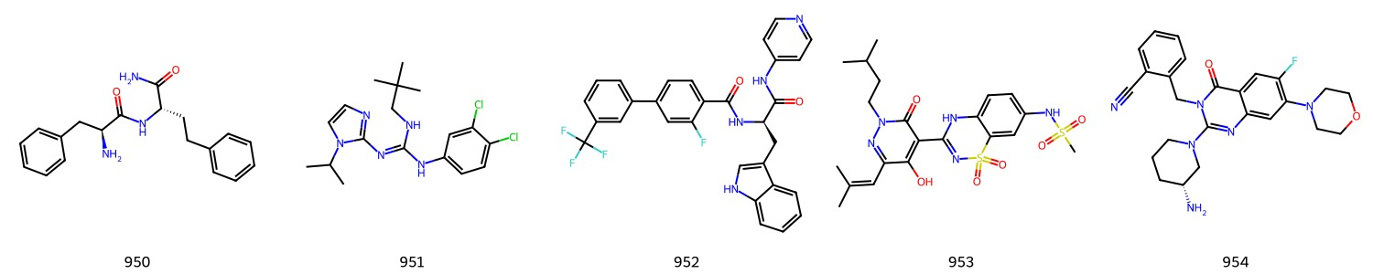
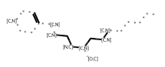
Group 8.5

Slide 7
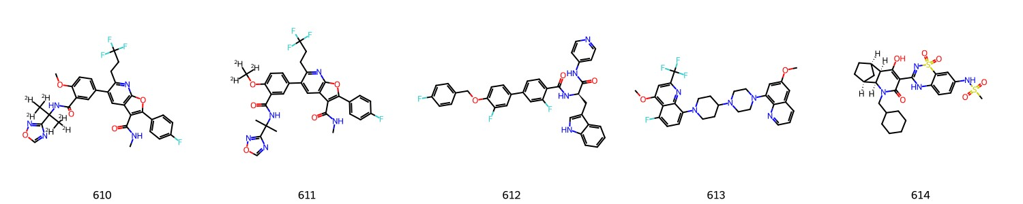
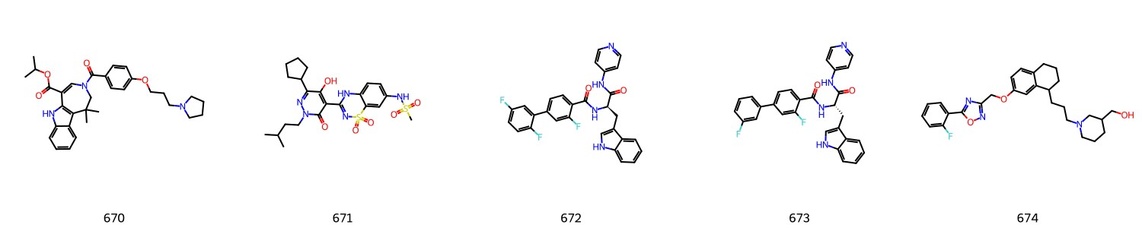
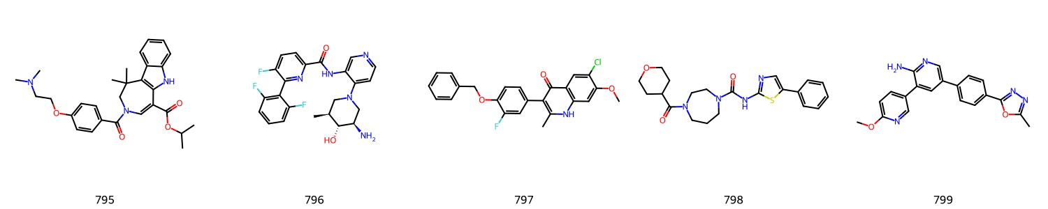
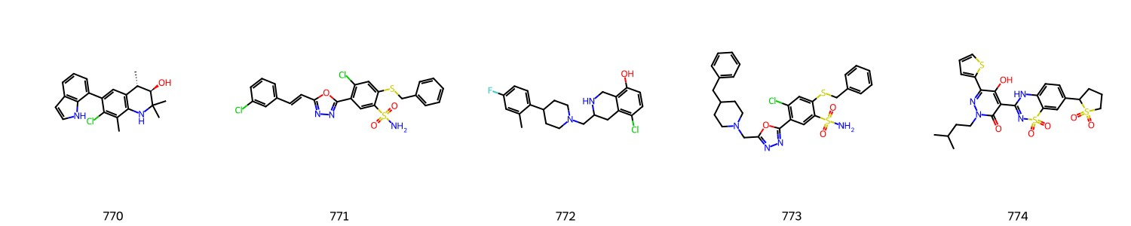
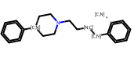
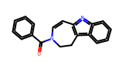
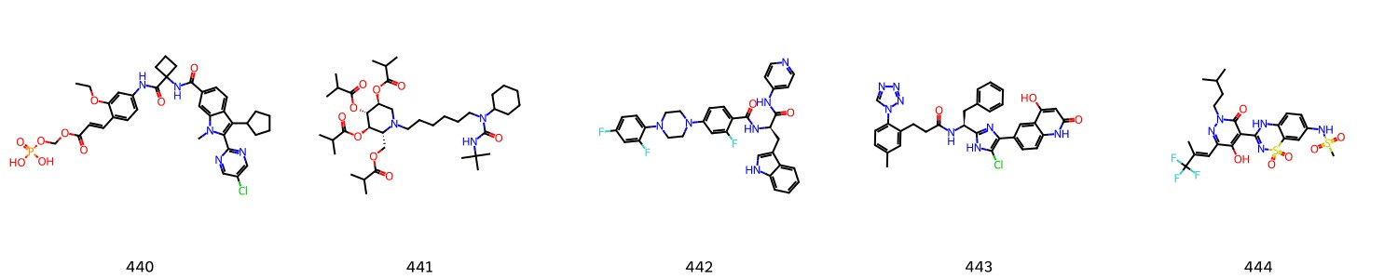
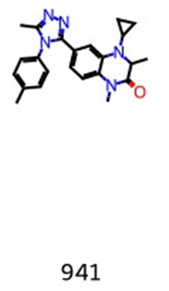
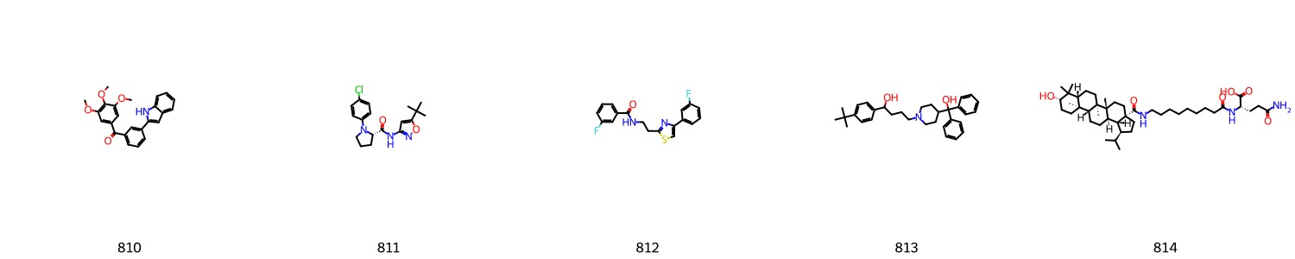
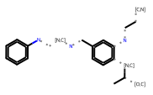
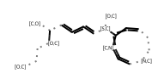
Group 8.6
Group 8.7
Group 8.8
Group 8.9

Slide 8
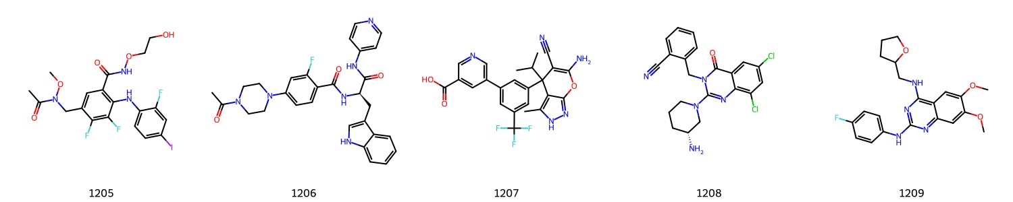
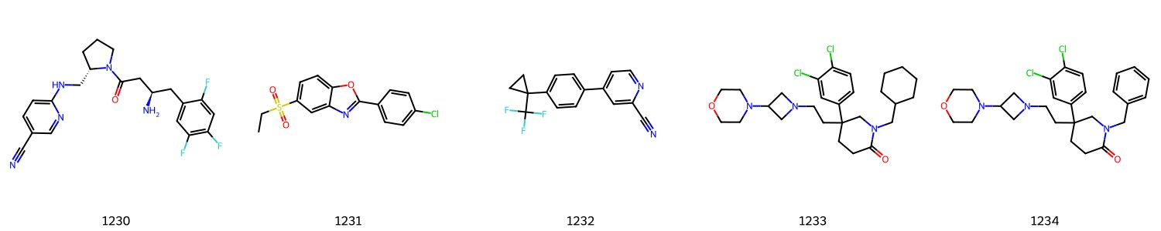
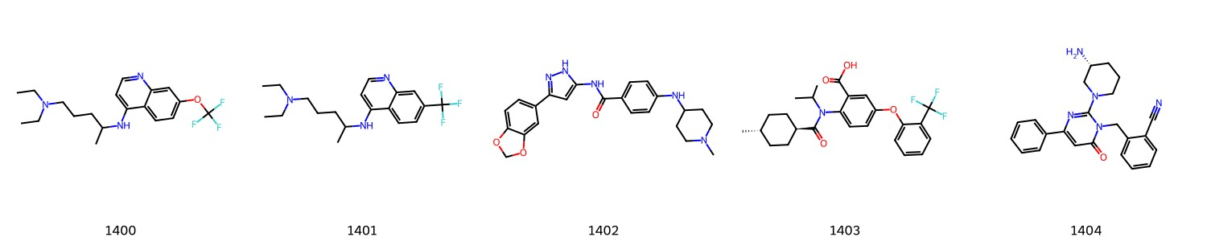
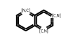
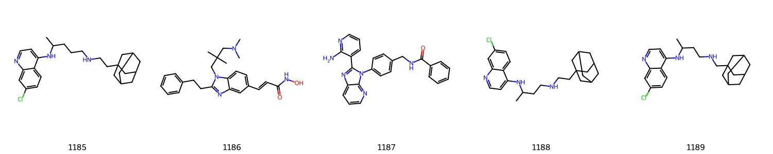
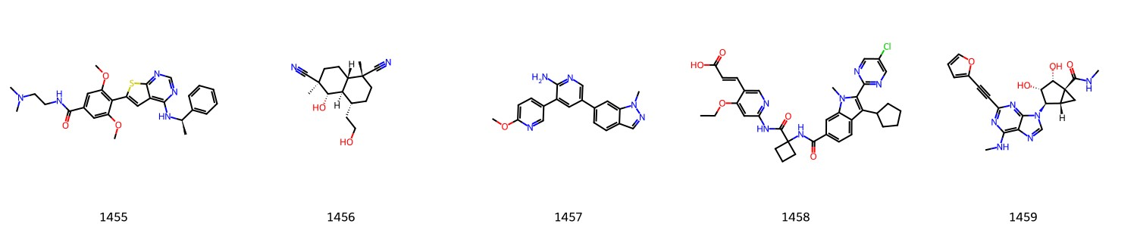
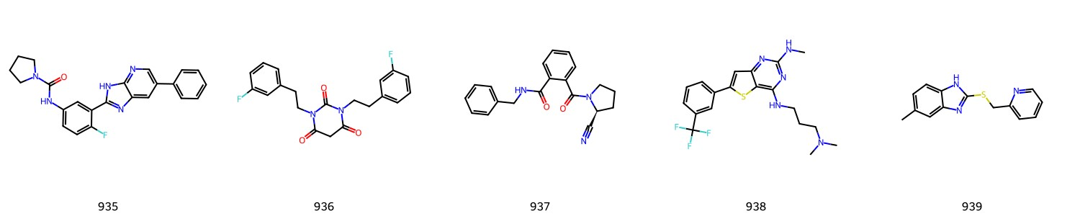
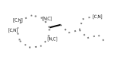
Group 8.12
Group 8.10
Group 8.11

Slide 9
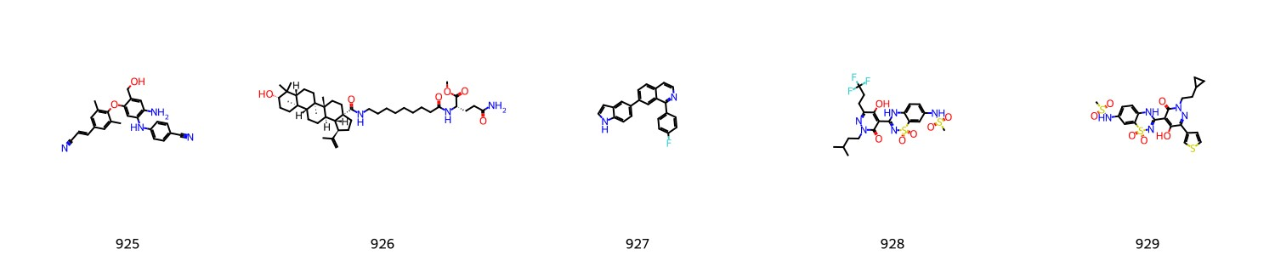
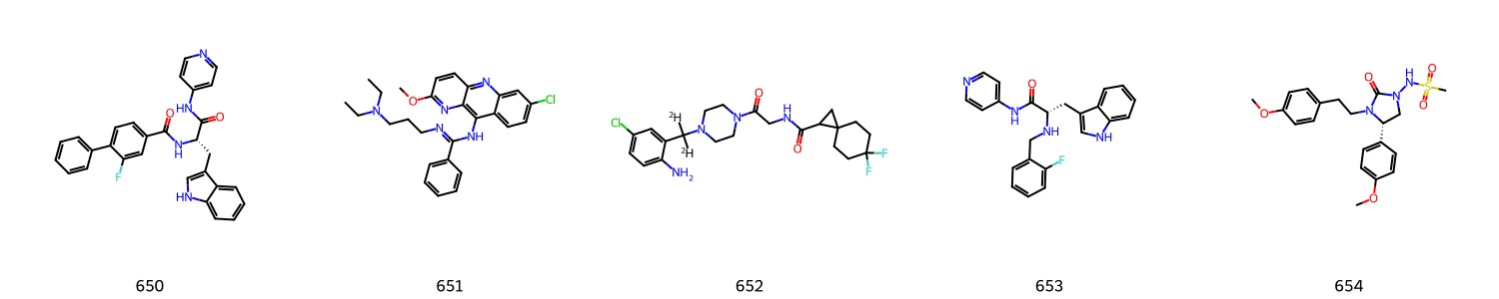
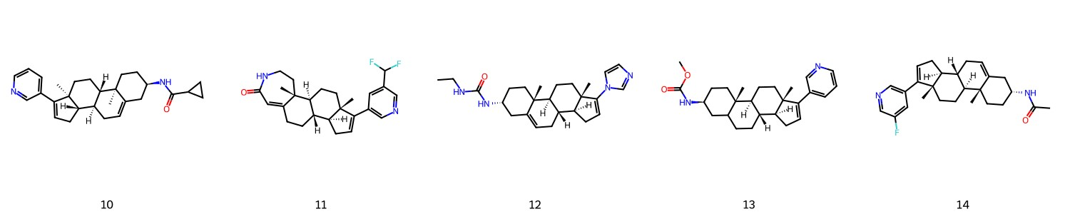
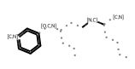
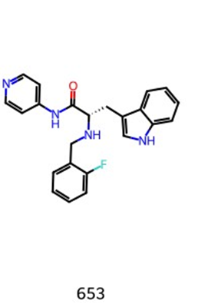
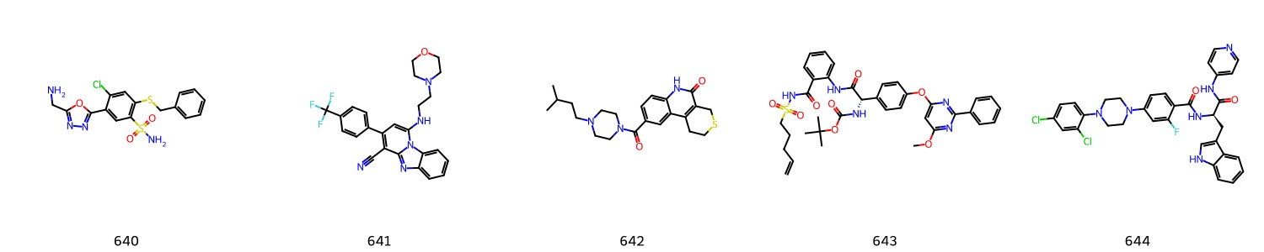


Kmeans, group 13 (6/6)
Group 13.1
Group 13.2

Slide 10










Kmeans, group 24 (18/20)
Group 24.1
Group 24.2
Group 24.3

Slide 11













Group 24.4
Group 24.5
Group 24.6
Group 24.7

Slide 12


MCS
MCS of MurckoScaffold
8.1: 1536 / 18
8.10: 1393 / 161
8.11: 1510 / 44
8.2: 1551 / 3
8.3: 1449 / 105
False / True

Slide 13

MCS
MCS of MurckoScaffold
8.4: 1478 / 76
8.5: 1477 / 77
8.6: 1524 / 30
8.7: 1531 / 23
8.8: 1532 / 22

Slide 14

MCS
MCS of MurckoScaffold
8.9: 1551 / 3
13.1: 1425 / 129
13.2: 1437 / 117
24.1: 1423 / 131
24.2: 1544 / 10

Slide 15

MCS
MCS of MurckoScaffold
24.3: 1535 / 19
24.4: 1513 / 41
24.5: 1501 / 53
24.6: 1539 / 15
24.7: 1540 / 14

Slide 16
8.1: 1536 / 18
8.10: 1393 / 161
8.11: 1510 / 44
8.2: 1551 / 3
8.3: 1449 / 105
8.4: 1478 / 76
8.5: 1477 / 77
8.6: 1524 / 30
8.7: 1531 / 23
8.8: 1532 / 22
8.9: 1551 / 3
13.1: 1425 / 129
13.2: 1437 / 117
24.1: 1423 / 131
24.2: 1544 / 10
24.3: 1535 / 19
24.4: 1513 / 41
24.5: 1501 / 53
24.6: 1539 / 15
24.7: 1540 / 14

